Slide 1


Prepared by: Dr. Sam Steel, NALP Safety Advisor
Updated June 2026
Heat Stress Among Landscape Workers
12500 Fair Lakes Circle, Suite 200, Fairfax VA 22033
703.736.9666 (phone) | 800.395.2522 (toll-free)
info@landscapeprofessionals.org

Slide 2
Disclaimer:
The information contained in this NALP training resource is reviewed periodically to ensure its accuracy and completeness. Please be aware that heat injury and illness events among landscape and lawn care workers are being documented through increasing incidents in many U.S. regions. Reliable health agencies and researchers are updating heat stress prevention and treatment protocols, and as a result, this resource will be subject to additions and corrections as new information becomes available.

Slide 3
Heat Stress Among Landscape Workers
Don’t Allow hot and humid weather to take its toll on your employees!
We will discuss:
Introduction to occupational heat exposure
Heat illness and heat stress defined
OSHA Heat Stress NEP and EPA/WPS
Tools for predicting the onset of heat stress
Weather conditions causing heat stress
Other contributing factors
Preventing heat stress among your employees

Slide 4
Introduction
Many workers in both indoor and outdoor environments are exposed to heat while working. Work involving high air temperatures, radiant heat, high humidity, direct contact with hot surfaces or objects, and strenuous physical activity can result in heat-related illnesses.
All of the above factors (and other circumstances) are potential exposure factors for landscape workers!
During this presentation we will carefully examine these contributors to heat stress and suggest methods for preventing or limiting their impact on worker safety and health.

Slide 5
Heat Illness and Heat Stress Definitions
THERMOREGULATION
Thermoregulation is the ability of the human body to adjust to excessively cold, or excessively hot environmental conditions.
This webinar will deal with the human body’s reaction to excessively hot conditions, referred to as HYPERTHERMIA.
When exposed to hot working conditions, the body must be able to get rid of excess heat to maintain a stable internal temperature (normally 98.6 degrees F.). If the body can not “regulate”, the body core temperature will rise to dangerous levels and result in progressively more severe heat-related illness.

Slide 6
Heat Illness and Heat Stress Definitions
ACCLIMATIZATION
This term refers to the gradual ability of the human body to adapt to increasingly more strenuous physical activity that takes place in a work environment with higher temperatures and humidity.
Essentially, new hires in the landscape industry may be asked to do manual outdoor work for which their bodies are not prepared.
Acclimatization may take a well-planned week or two of increasingly more strenuous work.

Slide 7
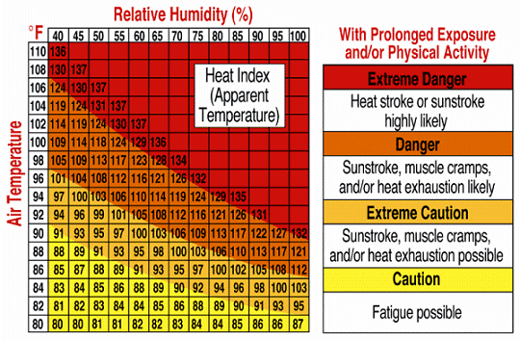
Heat Illness and Heat Stress Definitions
HEAT INDEX
The heat index is a combination of air temperature and relative humidity and how comfortable/uncomfortable humans feel when exposed to this modified air temperature.
Since the human body normally cools itself through perspiration and evaporation, anything that interrupts this process like high humidity, can lower the rate of body heat removal and result in some level of heat stress.

Slide 8
Heat Illness and Heat Stress Definitions
Six levels of occupational heat illness
A breakdown of heat-related illnesses on this list is ranked less serious to those that are “life-threatening” and would include:
Heat Fatigue
Heat Rashes
Heat Collapse (aka “fainting”)
Heat Cramps
Heat Exhaustion
Heat Stroke
LEAST SEVERE
MOST SEVERE

Slide 9
Heat Illness and Heat Stress Definitions
HEAT FATIGUE
Under most work conditions, new or replacement workers who are not used to warm work environments (have not been acclimatized) are prone to this ailment.
Symptoms include impaired sensorimotor skills, and impaired mental or vigilant decision-making. Since many landscape workers may be using powerful machinery, what are the potential risks when heat fatigue sets in?
Could the worker make an unsafe choice of taking a short cut, or use the machine carelessly to get the job done quicker?

Slide 10
Heat Illness and Heat Stress Definitions
HEAT RASH
Heat rash or prickly heat, is a very common problem in hot work environments.
Body areas exposed to restrictive clothing often become covered with red papules that cause a prickly sensation.
Profuse sweating that keeps the skin continually wet under warm conditions can result in a skin infection.
Heat rash usually cures itself when the victim returns to a cooler, drier environment.

Slide 11
Heat Illness and Heat Stress Definitions
HEAT COLLAPSE
(aka “fainting”)
Heat collapse is usually the result of blood pooling in the body’s extremities and not carrying enough oxygen to the brain. This can result in a lack of consciousness very quickly and unexpectedly.
Workers who are not used to, or prepared for, strenuous work during warm and humid weather are most susceptible to this early onset heat stress symptom.

Slide 12
Heat Illness and Heat Stress Definitions
HEAT CRAMPS
Heat cramps are attributed to an electrolyte imbalance related to sweating during hard physical work. Health practitioners suggest that the symptoms result from both too much, or too little salt.
The water lost by excess sweating while working must be replenished in order to minimize heat cramp conditions.
Please don’t use “thirst” as a guide to water replenishment! Water should be taken regularly every 15-20 minutes while doing physically demanding landscape work under hot weather conditions.

Slide 13
Heat Illness and Heat Stress Definitions
HEAT EXHAUSTION
Don’t be confused about the symptoms of heat exhaustion. It could mimic as an upset stomach, but during hot weather work, headaches, nausea, vertigo, muscle weakness, thirst, and giddiness may indicate the onset of this serious ailment.
Do not ignore the serious implications related to exhaustion and fainting while operating machinery and as a precursor to heat stroke.
Coming to work tired to begin a new work-day may increase the risk for heat exhaustion.

Slide 14
Heat Illness and Heat Stress Definitions
HEAT STROKE
Heat stroke is a MEDICAL EMERGENCY that needs IMMEDIATE TREATMENT. It occurs when the body’s temperature regulation system is unable to maintain a normal body temperature at or near 98.6 degrees F.
Symptoms include confusion, irrational behavior, loss of consciousness, convulsions, lack of sweating, hot-dry skin, and an abnormally high body temperature – at or above 105.8 degrees F.
Some medications critically increase the onset of heat stroke. Workers should carefully check medicinal labels for warnings.
Organs will shut down making survival very difficult.

Slide 15
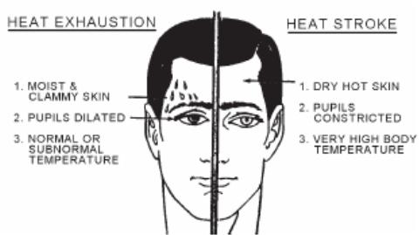
Methods for identifying heat exhaustion v. heat stroke

Slide 16
Heat Illness and Heat Stress Definitions
Heat Stroke Case Study
NIOSH FACE Report review from Michigan (2002)
Type of Work – Residential lawn care, including mowing, edging, trimming and back-pack debris blowing.
Work Crew – Two-member residential crew, victim was laborer
Weather Conditions – Maximum temp during this workday was 81 degrees F. during the afternoon.
Symptoms – Reported illness to crew supervisor at 3 pm as being light-headed and short-of-breath. Refused assistance at that time. Collapsed at 5 pm and was taken to emergency care facility where rectal temperature was determined to be 107.6 degrees F.
Death of worker attributed to organ shutdown due to extremely high body core temperature and multi-drug intoxication.

Slide 17
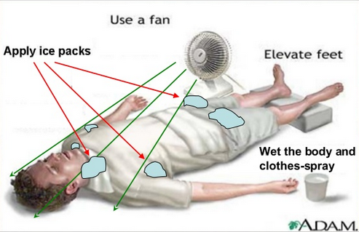
Methods for treating heat stress conditions
Call for EMS assistance immediately and remove the victim from direct sunlight to a well-ventilated location.
Don’t be fooled by an apparent quick recovery! Heat exhaustion is just one step removed from a potentially fatal heat stroke.

Slide 18
Non-Exertional Heat Stroke
Non-Exertional Heat Stroke NEHS
This type of heat stroke resulting from abnormally high body temperature (>105.1 degrees F.) is caused by excessive environmental heat and impaired bodily heat loss.
This hot environment illness typically affects: the elderly; individuals who have consumed alcohol or have taken certain medications or stimulants; and victims exposed to very hot conditions in an environment with no cooling or ventilation.

Slide 19
Exertional Heat Stroke
Exertional Heat Stroke EHS
This type of heat stroke is more common among outdoor workers exposed to strenuous physical activity in a hot, humid environment.
It is not limited to just older individuals and can severely impact your young and healthy workers, even those who have not taken any medications.
New, replacement, and other workers who have not been acclimatized to hot work environments for 1-2 weeks are especially at risk.

Slide 20
Comparing Hypothermia v. Hyperthermia
● Normal human body temperature is +/-98.6 degrees F.
● Notice that the difference between too cold and too hot is only 6.7 degrees F.
● WARNING: NIOSH FACE Report on a heat-related workplace death of a landscape worker documented an emergency room rectal temperature reading of 107.6 degrees F.
HYPERTHERMIA
HYPOTHERMIA
Elevated
body
core
temp
►101.7 F
Reduced
body
core
temp
◄95.0 F

Slide 21

OSHA Heat Stress – Related Standards
OSHA Standards that apply and take into account the following occupational heat exposure factors:
Rising temperature
High humidity
Intense sun exposure
Lack of air movement
Machines radiating heat
Strenuous work
Requirements for PPE
OSHA General Duty Clause – Employers are required to provide their workers with a place of employment that “is free from recognizable hazards that are causing or likely to cause death or serious harm to employees.”
OSHA Personal Protective Equipment (PPE) Standard 29 CFR 1910.132(d) for determining the appropriate PPE (based on occupational heat exposure) to be used for protecting employees from hazards identified during worksite assessments.
Be aware that 28 states have a “state OSHA plan” that may include more specific occupational heat exposure regulations.

Slide 22
OSHA Heat Stress – Related Standards
An example of an OSHA state plan and its specifics
Providing shade
Providing potable water
California is one of the 28 states with a “state OSHA plan” that may include more specific occupational heat exposure regulations.
In 2015 it was necessary for Cal/OSHA to clarify the wording and requirements on heat illness prevention. Here are just two of the 2015 revisions.
Provision for water – Water must be fresh, pure, suitably cool and provided “free of charge”.
Access to shade – Employees taking a preventative cool-down rest “shall be monitored and asked if he or she is experiencing symptoms of heat illness”. Cool down rest areas must be readily accessible.

Slide 23

EPA Worker Protection Standard
The EPA Worker Protection Standard (EPA WPS) was promulgated to protect workers from exposure to agricultural pesticides. The revised EPA WPS published in 1992 included provisions for heat stress management. This was necessitated because of the impermeability of PPE during chemical application work and its required use during re-entry into treated areas before the REI’s (Restricted Entry Intervals) had expired.
Find additional guidance at www.epa.gov/

Slide 24
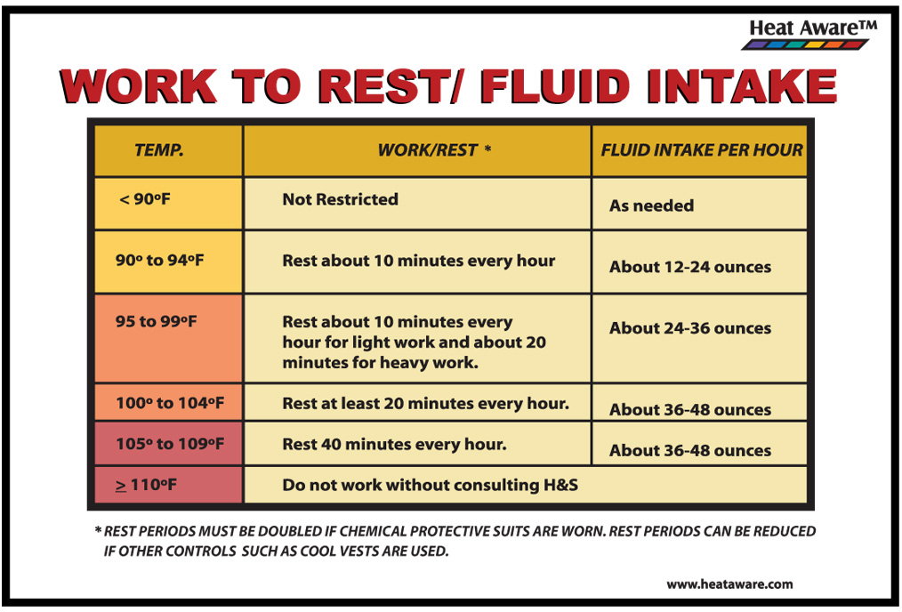
Tools for predicting the onset of heat stress
Monitoring tools to use for taking into account the following factors:
Rising temperature
High humidity
Intense sun exposure
Lack of air movement
Machines radiating heat
Strenuous work
Requirements for PPE

Slide 25
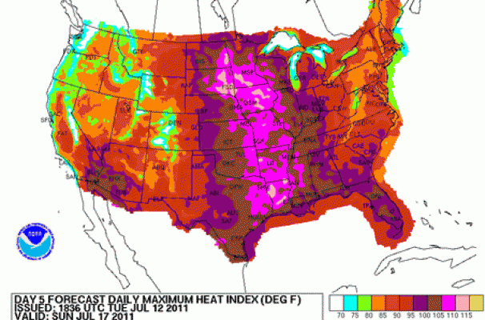
Weather conditions causing heat stress
Tools for predicting heat stress conditions
NOAA weather maps can assist employers in preparing for hot weather work. Some extremely strenuous work may need to be delayed due to dangerously high temperature extremes and excessive relative humidity.
NOAA – National Oceanic and Atmospheric Admin.

Slide 26
Other contributing factors to occupational heat stress
AGE
The factors that contribute to an increased risk of heat stress among older workers are:
Older workers are not able to adjust as quickly to sudden increases in temperatures.
Older workers are more likely to have medical conditions, including interrupting the body’s normal ability to respond to hot and humid work environments.
Older workers are more likely to be taking prescription drugs that negatively impact the body’s core temperature regulation, including the cooling effects of perspiration with evaporation.

Slide 27
Other contributing factors to occupational heat stress
MEDICATION
Medications including prescription and over-the-counter drugs like antihistamines for easing the symptoms of a runny nose from allergies, will also inhibit normal sweating. This impacts the body’s ability to cool itself.
Beta blocker meds for high blood pressure are also problematic. Heat stress normally increases heart rate or the pumping of blood in vessels under the skin where convection can rid the body of some heat.
Beta blocker heat stress symptoms are difficult to assess at the worksite because fellow workers will not recognize the magnitude of the medical emergency until its too late, especially when a heat stroke has reached a critical stage with an extremely high body core temperature.

Slide 28
Other contributing factors to occupational heat stress
ALCOHOL/STIMULANTS
Alcohol is a diuretic, meaning it promotes dehydration in the body. This condition interferes with the body’s ability to regulate its own temperature and may support the onset of heat stress. Fluids that would normally cool the body through perspiration are more often excreted as urine when the body dehydrates.
One of the heat stress stages, namely heat exhaustion, is characterized by dehydration. If left unrecognized and untreated, the more serious heat stroke stage may follow with tragic consequences, including extremely high rectal temperature readings above 105 degrees F., organ failure, and death.
Stimulants are products that increase body activity and may be taken for weight loss, depression, and other conditions. Check product labels for health warnings related to hot/humid work conditions.

Slide 29
Preventing heat stress among your employees
Preventing and reducing the potential for heat stress among your employees
Carefully monitor workplace temp & humidity.
Schedule physically demanding work during cooler hours.
Acclimatize your workforce in phases – 7-14 days is a typical acclimatization period.
Decrease work/Increase rest
Provide shade, rest breaks, and liquids!
Halt work under extremely high temperatures.
Train your workers on recognizing heat stress symptoms.

Slide 30
Things to remember
Thirst is not a good indicator of the need for drinking water at the worksite.
Occupational heat stress has side effects that may not be apparent to the worker or supervisor.
Acclimatization takes 7-14 days to achieve for most workers and can be undone in 4-5 days.
It doesn’t take extremely high air temperatures for the onset of heat stress – medication can be a factor.
Even the mildest types of heat stress can seriously affect the ability of workers to operate machinery.
Locations where air temperatures can be extreme need a “hot weather work” training program.

Slide 31
Additional References on Heat Stress
OSHA General Duty Clause https://www.osha.gov/generaldutyclause
Heat Stress: A Hazardous Occupational Risk for Vulnerable Workers. NIH National Library of Medicine, June 1, 2023.
Heat Exhaustion. Cleveland Clinic, October 1, 2024.
Heat Stress and Workers. CDC-NIOSH, March 3, 2026.
Heat NEP (OSHA National Emphasis Program). CPL 03-00-024, www.osha.gov, April 10, 2026.

